Slide 1

VATES
Owen Arnold, Michael Reuter, Alex Buts, Martyn Gigg, Andrei Savici, Nick Draper
Notes:
I’d like thank the conference organizers for the opportunity to talk about the VATES project.
The VATES project was started in 2010 to provide advanced visualisation and analysis of neutron scattering data. I work as a software engineer on that project.

Slide 2
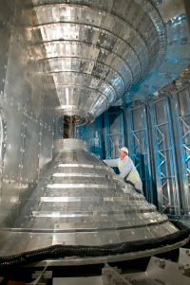
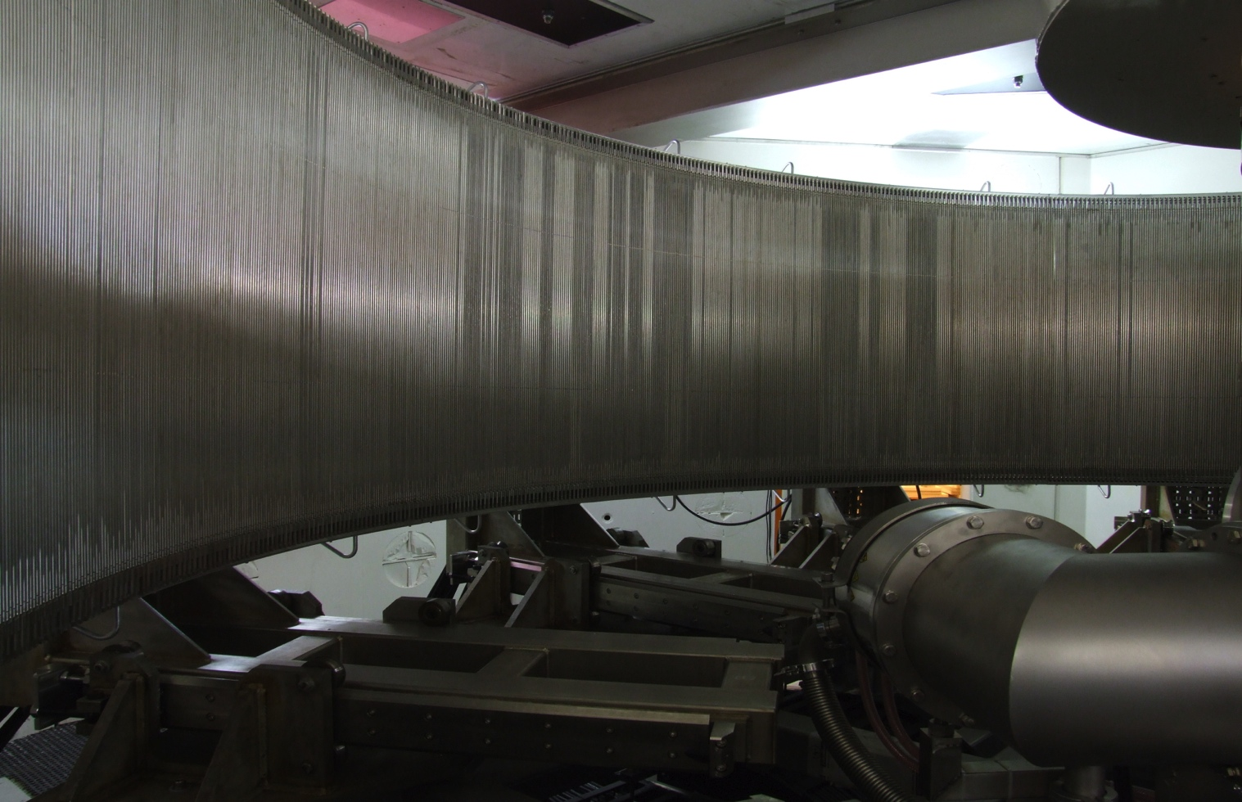
VATES : The problem
Highly pixelated instruments
Large data volumes
Many dimensions of interest
Need for n-dimensional data manipulation
One workbench required
1520 tubes
x 128 pixels
x 5000 time channels
160º
+/- 15º
Notes:
For our time of flight instruments we collect a large volume of dat. Multiple runs comprise of many dimensions of interest are collected. For example, in inelastic single crystal spectroscopy experiments, you may collect data comprising of many different components of momentum transfer as well as delta energy.
The instrument scientists also told us that continually swapping data around between adhoc tools was unacceptable. They wanted a workbench environment.

Slide 3
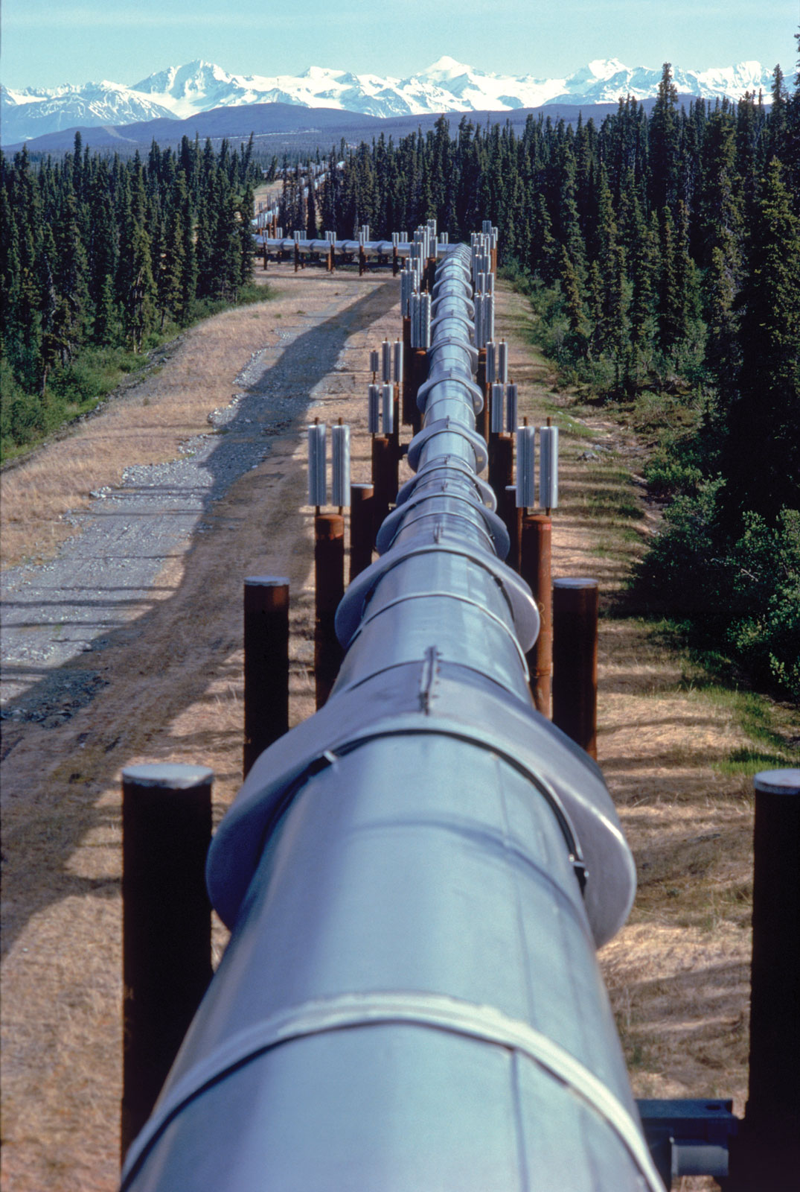
VATES : Requirements
Containers and pipeline for multi-dimensional data
Visualisation of multi-dimensional data
Simulation and fitting of multi-dimensional data
Pluggable/Extendable in many ways
Notes:
So this is what the requirements of the project boil down to.
Containers and algorithmic steps or nodes for multidimensional data. Within that.
Flexibility both in terms of the dimensionality of the data, and the ability to change and adapt the pipelines at will
Need efficient multidimensional data format both histogrammed and sparse.
We need the ability to visualize multidimensional data at any point, and also the ability to drive algorithmic steps in the visualisation mode in-situ.
We need the ability to simulate multidimensional data and to provide fitting features.
We need the ability to grow the project, both internally, and also by external contributors.

Slide 4
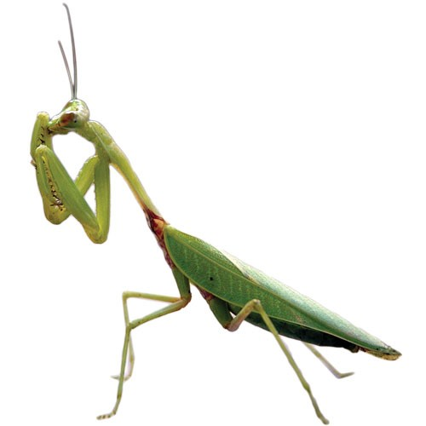
Platform Design Choice: Mantid
Mantid: Instrument and technique independent Data Reduction and Analysis.
Joint project by ISIS and SNS
Overlap in target platforms
Overlap in common functionality
Assemble one continuous chain
Shared maintenance effort
No need for another standalone tool
Notes:
Our primary design choice as a platform for the work has been Mantid.
Mantid is an instrument and technique independent data reduction and analysis framework, which you will have heard about over the course of this conference.
There are a lot of reasons why this has been a good decision:
From my perspective as a software developer, the low overheads of project startup, and the shared maintenance effort have been particularly appealing.
For our users perspective, they have shaped Mantid, and they know how to use it. Adding to an existing workbench gives us the aforementioned one-stop-shop.

Slide 5
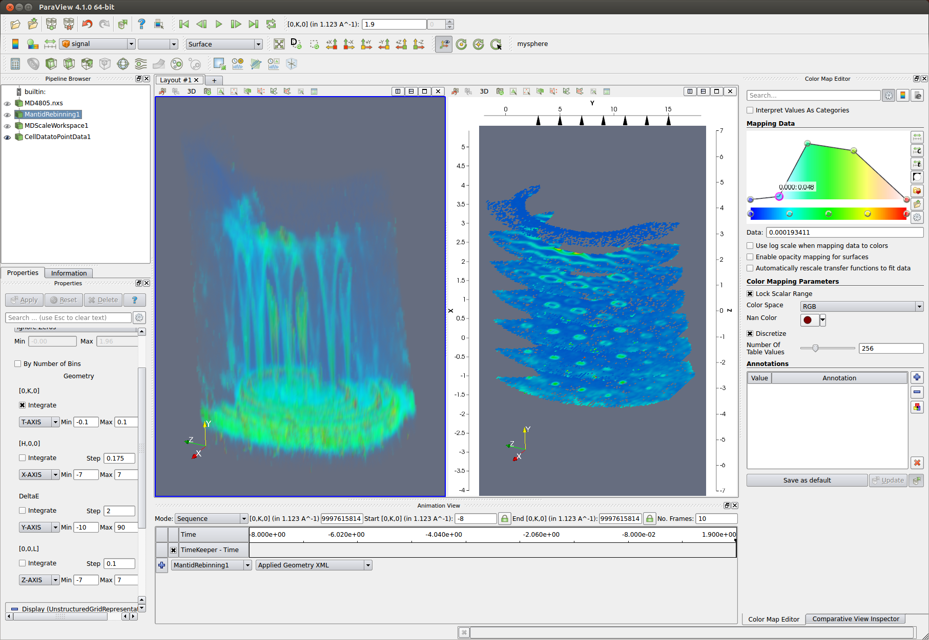
Platform Design Choice: ParaView
Cross-platform
Well supported
Open source
Pipeline branching
Suitable for large volumes of data
Notes:
Our second design choice has been paraview.
Has been used for visualizing terabytes of data
Very powerful user interface
Well supported.
Easily pluggable in terms of filters and loaders, but also options for customisation of the user interface itself.

Slide 6
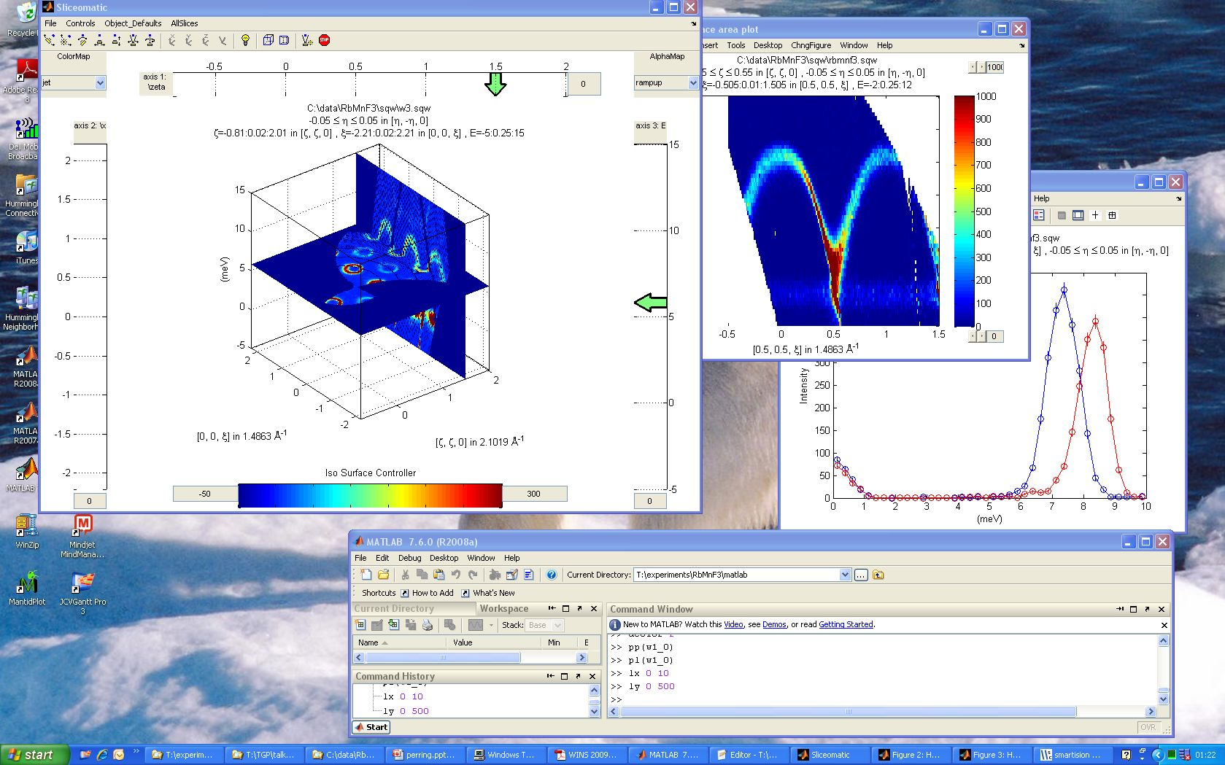
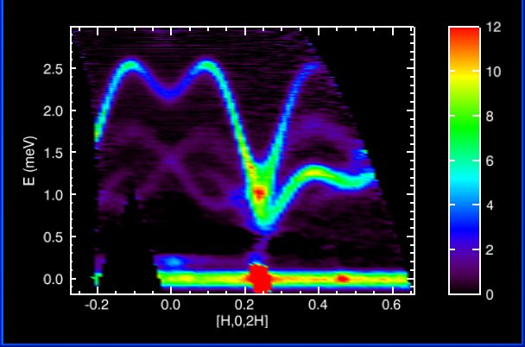
Previous and Existing Tools
Many successful tools to draw ideas from and extend
Notes:
We haven’t ignored existing tools, quite the opposite.
The community has provided a lot of good and successful tools. Horace, Tobyfit, Mslice, Dave, Isaw and others have all been used to steer the development. We have also been fortunate enough to have input from some of the developers of these tools at various points in the project.

Slide 7
Historic Overview
2010
2011
2012
Prototypes
Dynamic rebinning
Mantid
Release 2.2
2012
Binary MD algorithms
Visualisation driven on the fly rebinning
VATES as plugin installer
nD Data formats
VATES
nD Visualisation
Simple Vates GUI
Slice Viewer
Combine Packaging
Paraview-Mantid Plugins
Mantid
Notes:
Lets have a brief look at where we are in the project.
We started with some proof of concept prototypes, before taking the ideas through to production. Some notable features being the introduction of binary MD algorithms, the 3D visualisation and the 2D slice viewer tools.
In 2012, Toby Perring gave a report of the project status as the last NoBugs.

Slide 8
Overview
2.3
2.4
2.5
2.6
3.0
3.1
3.2
2012
2013
2014
3D non-orthogonal projections
Stress testing
Peak Reporting
PSI & ILL involvement
Natural Coordinates
Optimization
VATES
Collaboration with Kitware
ParaView Upgrade
Scriptablity
MD Normalization …
VATES algorithms in Instrument View
nD Connected Component Labeling
PeaksViewer
Expand MD Algorithms
Mantid
Fold project
SC reduction interface
Experiment with the VSI for imaging
Notes:
Since then we’ve been working hard to drive the project forward.
I’ve selected a few key features to show against each release.
I’ll focus on some of those in more detail on the coming slides.

Slide 9
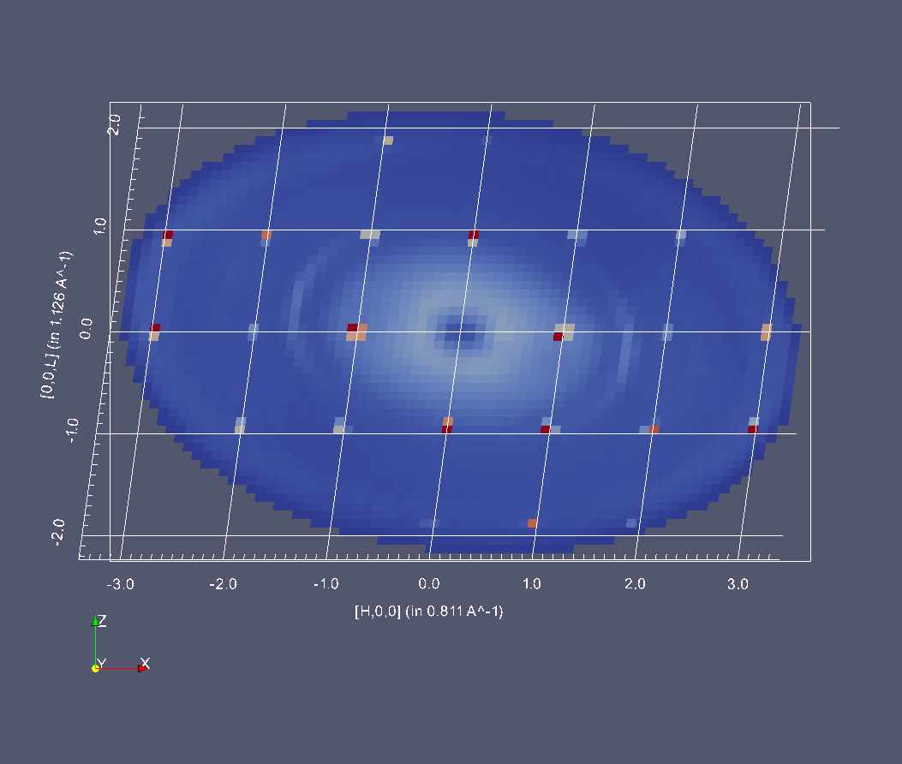
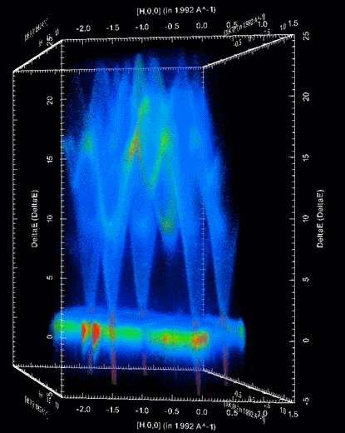
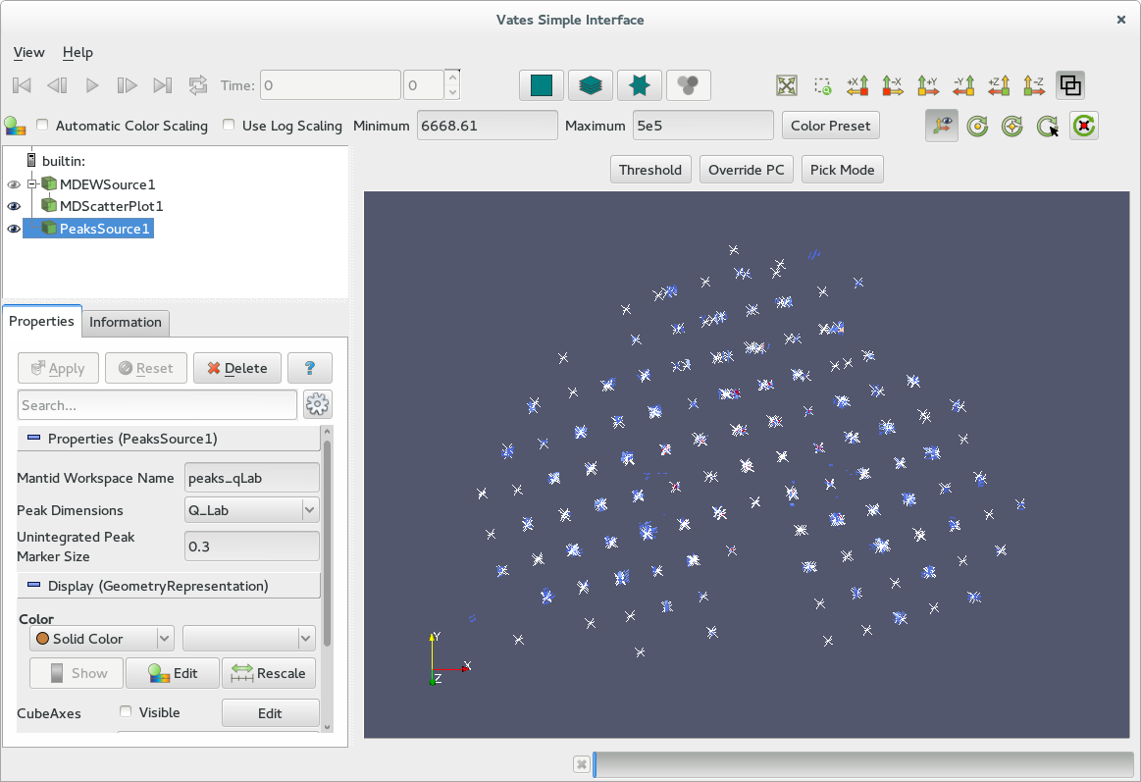
Multi Dimensional Visualization
Notes:
We have built into the 3D visualization the ability to switch between coordinate systems. For example going from orthonormal to triclinic.
This non-orthogonal visualization was a collaborative effort, not just amonst the mantid collaborating facilities, but also within Kitware.
We’ve improved our 3D VATES Simple Interface (VSI) in quite a few ways, but most notably providing the ability to overplot data.
The B matrix is used to provide the transform from triclinic to orthonormal.
Figure 1: Br_PHCX_75_E0 measured where?
Figure 2: A non-orthogonal 3D projection of Spin Waves in Gd as measured on SEQUOIA.

Slide 10
Model Fitting and Simulation
Visualisation ⬅➔ model fitting/simulation
Highly iterative procedure
Require seamless integration with Mantid and visualisation
Allow user-supplied models for scattering
‘foreground’: typically global across dataset + resolution
‘background’: simple (e.g. Linear background), no resolution
Links with existing Mantid Fit framework
Foreground and background models are extendable
Notes:
Another area that we are actively working on is model fitting and simulation.
This is a highly iterative process, in which cuts and slices are selected visually and then used.
This requires close coupling between the visualization and the rest of the working environment.
Mantid is extensible from the core, up, and this has made it quite easy to add new foreground and background models. Another feature, which we are yet to fully utilize is the concepts of the virtual instrument, which could be useful in setting up the instrument resolution calculations.

Slide 11
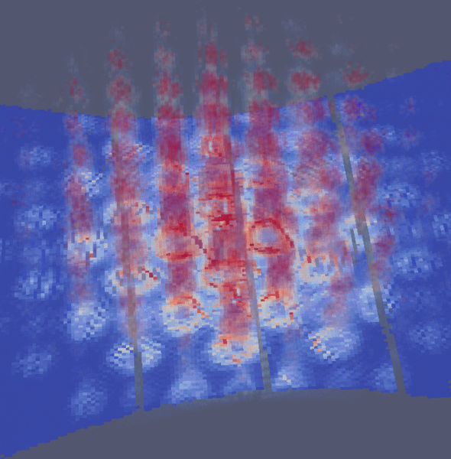
Model fitting: current status and forward view
Verify & expand stock foreground model library
Speed optimisation
User interface:
easy-to-use templates for simple user models
Work-bench interface
Distributed computing (clusters)
Possible investigation into using GPU resources
Other resolution function models
Simulation of MERLIN instrument resolution convolved with a Strontrium122 foreground model
Notes:
One area we will be working on in the near future is in making it easier for individuals who are not connected to the development team ot add their own models. We will probably achieve this through a combination of templates and scripts.
Other areas we will be working on is providing as user interface, as well as working out how to speed up the calculations.

Slide 12
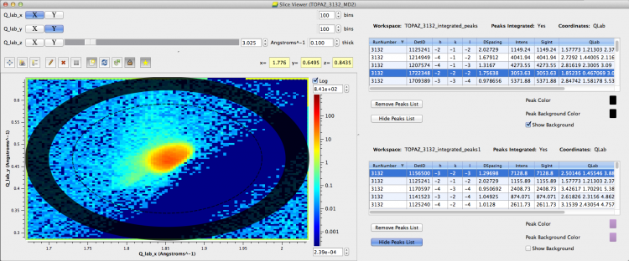
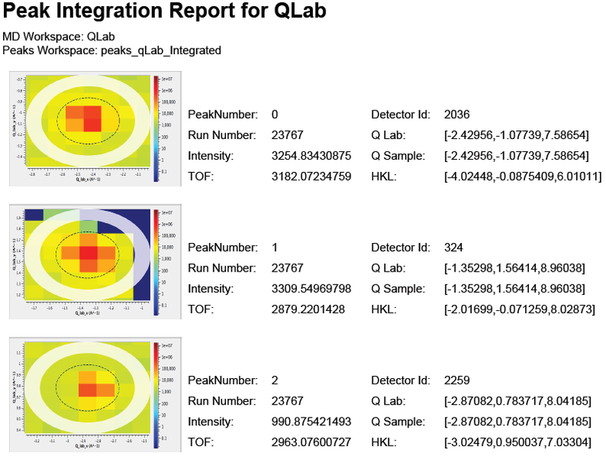
PeaksViewer
Notes:
Peak identification, indexing and integration is an area we have spent time on since the last release. Users and instrument scientists, particularly single crystal elastic diffraction users, want to see where peaks have been identified, and how they have been integrated.
The PeaksViewer is a new feature, which is an extension for the SliceViewer, our 2D projection tool.
It allows one to zoom to a peak in Q-space
We can overplot several peaks lists simultaneously
We can script it in python
We can generate PDF output peak reports

Slide 13

PeaksViewer
Notes:
Here’s an animation I put together showing how the peaksviewer can be controlled in python. After alutomatically finding and integrating the peaks, I sort them by intensity, then use the PeaksViewer to show the first few most intense ones.

Slide 14
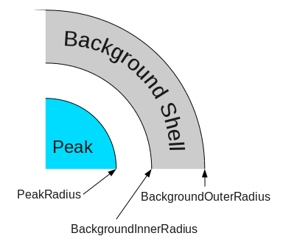
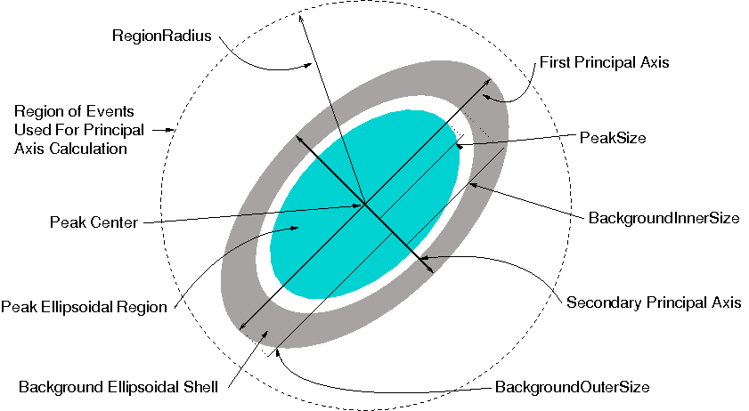
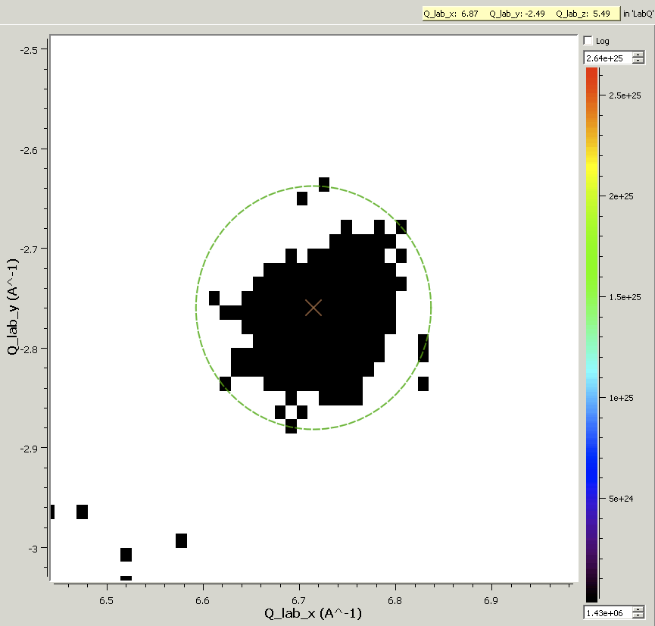
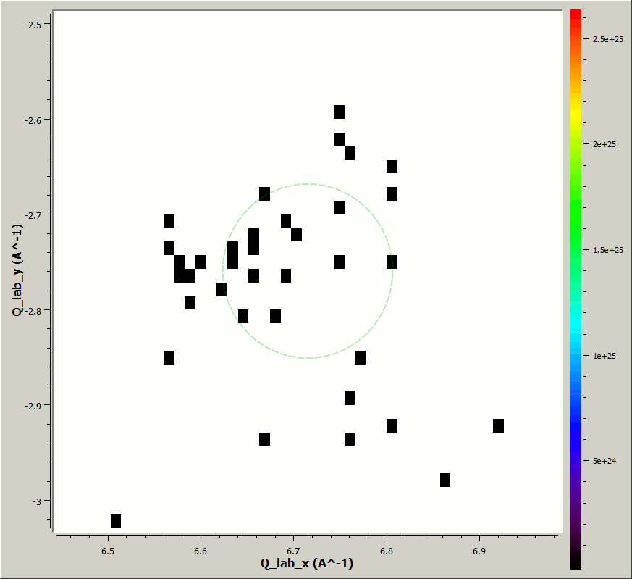
Peak Integration
Heavily uses both Mantid and VATES
Started out with a spherical integration algorithm
Ellipsoid integration
Experimenting with CCL approach
Notes:
Peak integration has been an exploratory and interesting area for us.
We started out with a spherical integration technique implemented at the SNS. Dennis Michelson, the developer behind ISAW, then implemented an elliptical integration technique.
Our current area of interest has been influenced by Larent Chapon as the ILL, and involves connected component analysis, as fast generic imaging technique. We have implemented a variation of this technique, which works in n-dimensions, and runs in parallel. The result being you are not constrained to a ‘shape’ for a peak. You need a rule way to identify a peak from the background.
In the animation, we are stepping into the plane in each timestep, any black pixels centered around the peak origin, and touching are considered part of the peak.

Slide 15
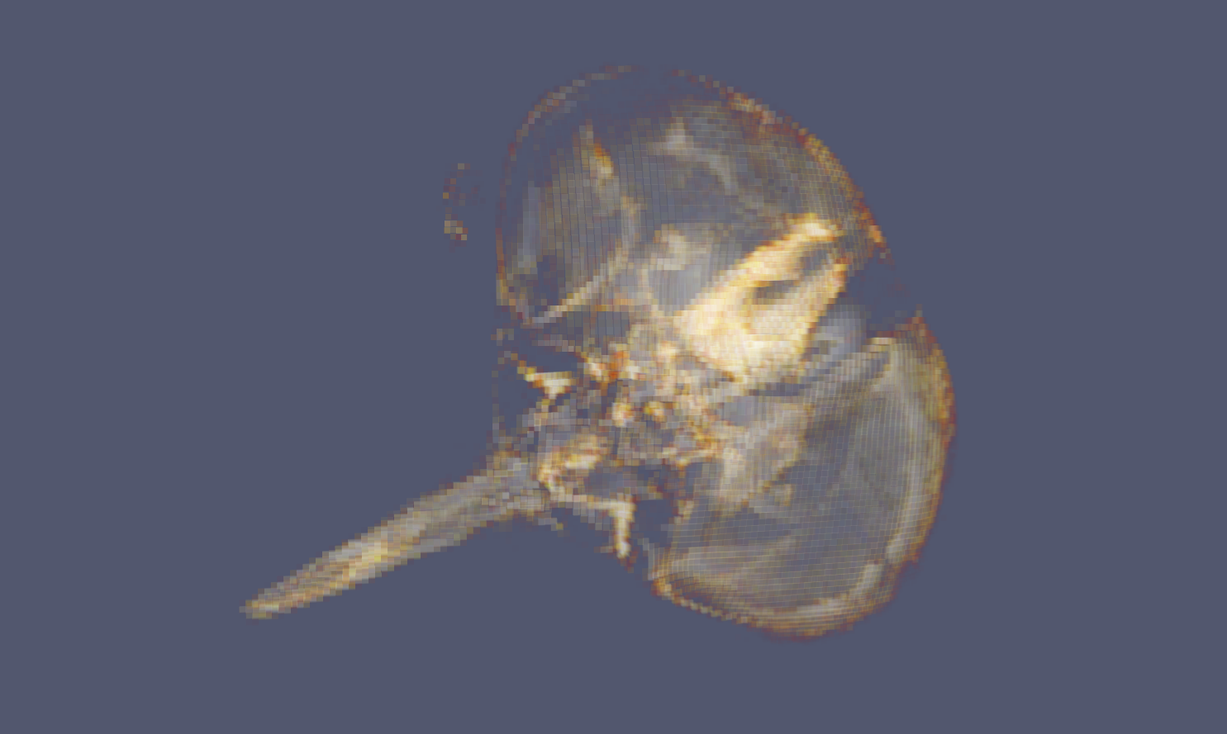
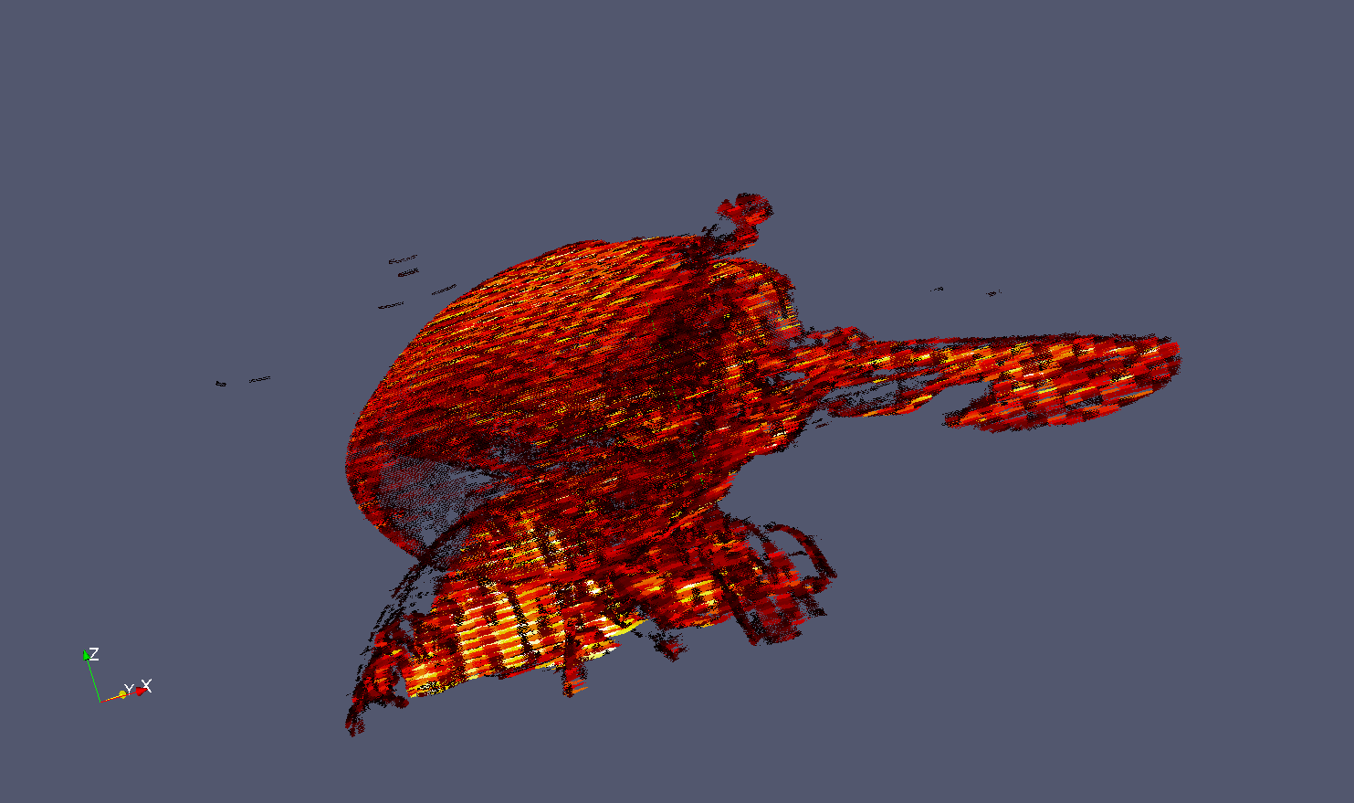
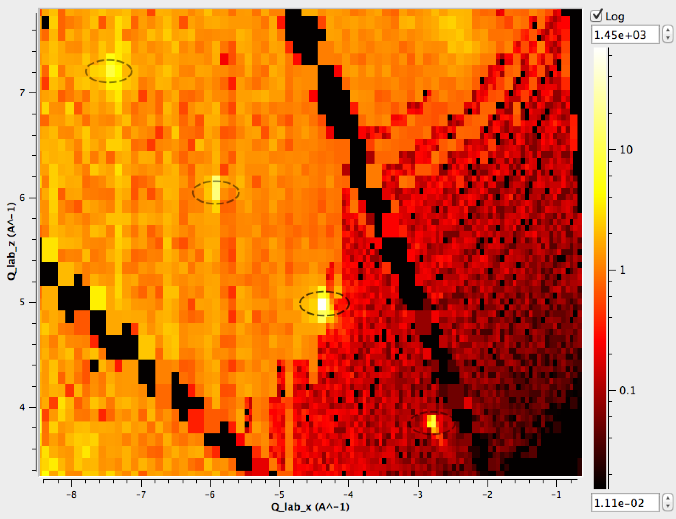
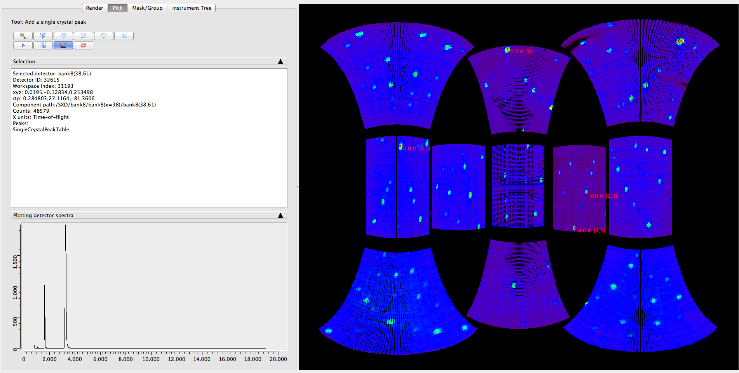
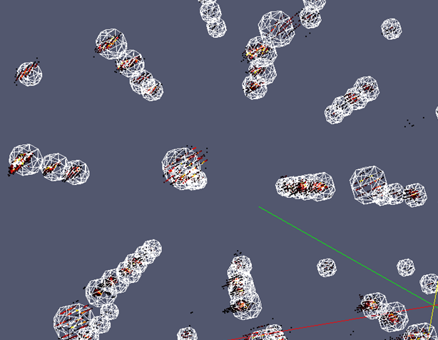
Two way interaction
Left: Slice through an multi-dimensional workspace in Q-lab. Algorithmic output fed into visualisation to show spherically integrated regions. Right: 3D representation of integration regions with Bragg peaks in Qlab. Both from cublic NaCl on SXD.
Notes:
There are some unexpected areas where we have found VATES to be useful.
We where able to view a fly’s head, in real-space, in the Vates Simple Interface, very easily and at very low memory cost using the same data structures we designed for sparse multidimensional data. This may open up other areas in imaging.
We have seen how the integrated peaks list can be represented in the 2D slicing tools, as well as the 3D ones.
We also have the instrument view, which is native to Mantid. We now use algorithms developed for the MD side of VATES to work with peakslists in detector space.

Slide 16
Looking Forwards
Complete scriptability. A well thought out API.
Better cohesion between tools.
MD normalization work.
Properly account for solid angle and flux in Horace scans
Processing of large datafiles.
Turning our attention to MPI and GPU processing
Continued scientific led development
Notes:
Don’t properly account for solid angle or incidents flux during Horace scans. Therfore are not correctly able to merge and normalize multiple scans.

